Slide 1
Welcome to: Destiny ACTIVATOR Unlocking Destiny
Life Coaching Workshop
Led by

Slide 2
Destiny Activator Life Coaching Workshop
Workshop Guidelines
© 2015 Tina Southgate

Slide 3
MODULE 1
DISCOVER
My Destiny in My Heart

Slide 4
Session 1 – My Destiny in My Heart Introductory Exercise
EXERCISE
Tell me about something or number of things you get love and excited about Partner is ONLY allowed to use affirming body language and say “Tell me more” or “Tell me more about that” “What else”
© 2015 Tina Southgate

Slide 5
Session 1 – My Destiny in My Heart Introductory Exercise
DEBRIEF
What happened to their body language when they were most excited? (eg- Tone of voice, eyes, gestures, position they were sitting) Which topics came up? Which topics felt most resonant? What part of their favourite topic made them most excited? When did they most come alive?
© 2015 Tina Southgate

Slide 6
Session 2 –Peak Event Exercise
QUESTIONS
Exactly what happened? Walk me through the experience step by step. Tell me about the environment, who was there what it was like? What emotions did you feel? At what moment(s) where you most alive? What was happening then? What impact did you have on others? What kind of task were you doing? How did you do it? What was accomplished? What else can you remember?
Note this is based on the DESTINY EVENT EXERCISE (Page 201 of Tony Stoltfz’s Christian Life Coaching Handbook)
© 2015 Tina Southgate

Slide 7
Session 2 - Peak Event Exercise
DEBRIEF AND LEARNING
What skills and gifting(s) were you drawing on? Who did you serve? eg – men, women, people at a certain point in their life? What impact or outcome would you love to see repeated as you move forward in your area of call?
© 2015 Tina Southgate

Slide 8
Session 2 – My Destiny in My Heart
Guided Visualisation / Encounter
© 2015 Tina Southgate

Slide 9
MODULE 1 – DISCOVER
CLOSING POINTS
Control, shoulds, should nots - points you away from your destiny Aliveness points to alignment to destiny / dissonance and indifference points away - misalignment Our hearts are a wellspring of life Strong emotion, resonance and passion points to destiny. Desire is Godly There is power in connecting with heart and head We can self guide through a peak life events to unpack clues to our purpose and future direction We can journey with Holy Spirit to co-create our future
© 2015 Tina Southgate

Slide 10
MODULE 2
UNDERSTAND
Prophetic Words, Dreams, Visions & The Seasons

Slide 11
Session 3 - Prophetic Words, Dreams, Vision and The Seasons
What Prophetic Words Give Us
Big Picture Direction Vision Encouragement Revelation about our Kingdom Identity Our True Character how God sees us Ideas Heavens Perspective Clues to our destiny Assignments/Mandates Promises Impartations Blessings Strategy
© 2015 Tina Southgate

Slide 12
Session 3 - Prophetic Words, Dreams, Vision and The Seasons
What they don’t give us
Blow by blow up to the minute instructions on whats next Exact dates and times Exactly how to prepare Strategy on how to get there Who to work with who not to All of the what not to dos The ‘container’ – job title Our commissioning Character Faith Obedience to follow through ‘Micro-management’ An ultimatum of what is to be
© 2015 Tina Southgate

Slide 14
Session 3 - Prophetic Words, Dreams, Vision and The Seasons
EXERCISE – Identifying words to work on today
Weighty
Resonant with your spirit
Ones that feel totally impossible
Ones that invoke fear
Ones that feel exciting
I
© 2015 Tina Southgate

Slide 15
Session 3 - Prophetic Words, Dreams, Vision and The Seasons
Character /Kingdom Identity
Who you are and your being call. What part of Jesus you embody and carry to the world
Doing/Mandates/Assignments
Areas where there Heavenly authority released for you to move in.
Promises & Blessings
Word of God spoken –eg – you will get married, you will have something
Directional/Visionary/Big Picture/Strategy
Any how tos, where to’s, who to’s, what to’s
Giftings/ Anointing/ Impartations
Areas where you have been given anointing which need to be activated and used in your life.
© 2015 Tina Southgate

Slide 16
Session 3 – Prophetic Words
KEY POINTS
Prophecies are ‘missions offered to us’ /invitations to accept with some but not all the details If we say yes we need to take practical steps of faith to prepare for them to come to pass We need to engage our faith, and grow our character to enter into our prophetic promises All prophetic words are not the same –some are directional, or for short term encouragement others point you towards long-term life time destiny and calling. Prophecies give us key clues as to where we have authority, and what our assignments are from heaven and ultimately our destiny and calling
© 2015 Tina Southgate

Slide 17
Session 4 - Prophetic Words, Dreams, Vision and The Seasons
Seasons
© 2015 Tina Southgate

Slide 18
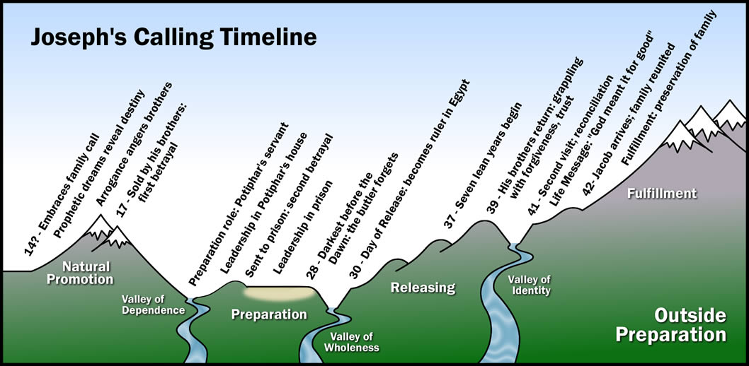
Your Calling Timeline (From The Calling Journey, by Tony Stoltzfus)
SHOW JOSPEPHS TIMELINE

Slide 19
Session 4 - Prophetic Words, Dreams, Vision and The Seasons
TIMING
24 Months
2-15 years
16-30 years
100,000s years
Mid-term
Long-term
Eternity Heaven
Short-term
Fulfilled
Source of faith building
Qualification for ministry
© 2015 Tina Southgate

Slide 20
Why are dreams important?
A people without vision perish Discovery of strengths and gifting Focus Creates ownership Makes us shiny and glorious Brings us alive and motivates Provides continual forward motion Tree of life Inspires others Shows who God is Pleases God Exercises our faith muscle Points to our purpose Brings us to our fullest impact Practice for heaven
© 2015 Tina Southgate

Slide 21
Session 4 - Prophetic Words, Dreams, Vision and The Seasons
KEY POINTS
All prophesies are not the same – Some words are directional, some are for short term encouragement others point you towards long-term life time destiny and calling. Prophesies give us key clues as to where we have authority, what our assignments are from heaven and ultimately our destiny and calling We need to say ‘yes’ and take practical steps of faith preparing for them to come to pass Calling is not just about doing Seasons & timing are vital to understand and align with No seasons are wasted – outside preparation, character preparation, life messages (being calling) Messy transitional seasons happen as do launch & birthing seasons The Lord will show us the future - We can co-create our timeline with God
© 2015 Tina Southgate

Slide 22
MODULE 3
OVERCOME
Skills Identification, Confidence & Boldness

Slide 23
Session 5 - Skills Identification, Confidence and Boldness
What tools do I have in my bag right now?
What do I need?..and
What tools need sharpening?
© 2015 Tina Southgate

Slide 24
Session 5 - Skills Identification Wheel
Non-Specific Skills
Specific Skills related to your calling
Life Skills
Time Mgt
Financial Stability
Vocational Experience
Character
Tenacity/Perseverance
Emotional Resilience
Vocational Qualifications
Relational
Communication
Living in community
Natural Abilities
Eg. Athletic, entrepreneurial, writing, art
Knowledge/Training
In area of vocation
Spiritual
Anointing
9 fruits of spirit
Hearing Gods voice
© 2015 Tina Southgate

Slide 25
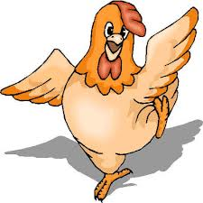
Session 6 - Skills Identification, Confidence and Boldness
Confidence and Boldness
Chicken lines and my destiny
© 2015 Tina Southgate

Slide 27
Session 6 - Skills Identification, Confidence and Boldness
Confidence and Boldness
Chicken lines and my destiny
Identifying my confidence & boldness
What’s looming ahead
Where I am equipped with boldness
© 2015 Tina Southgate

Slide 28
Session 6 - Conquering my looming chicken line
What is the looming chicken line in a sentence or two?
How much fear do you feel out of 10? (ensure it is at least an 8 out of 10!)
How can you apply what you know about your previous strategy to this situation?
What do you now know you have character wise?
What strategies that you used previously can be applied here?
How could God show up this time?
How fearful out of 10 do you feel now?
© 2015 Tina Southgate

Slide 29
Session 6 - Skills Identification, Confidence and Boldness
Summary of Key Points
I can identify where I am strong and skilled and where I need to grow and I can set goals based on areas I need to grow in
Skills are not just job related, there are many areas of my life to grow skills in to become the best possible person I can be.
Rounding off my skill set helps me decide on my next best steps
The more I am aware of where I am strong the more confident I am
Chicken lines are a part of life and I already know how to overcome them.
I have characteristics that enable me to overcome fear and walk into the next step of my destiny
‘To him who much has been given much is expected’
© 2015 Tina Southgate

Slide 30
MODULE 4
LAUNCH
What do I do next?
Bringing the jigsaw pieces together

Slide 31
MODULE 4 – What do I do next?
These sessions are about ‘launching’! This will involve:
Making a Choice and Decision
Drawing the jigsaw pieces together!
Learning how to consider all our options
Then learning how to narrow down our options, and
Setting some achievable goals.
© 2015 Tina Southgate

Slide 32
Session 7 – My future
Encounter - A letter to you from you co-created with Holy Spirit
Firstly date the top of the page
© 2015 Tina Southgate

Slide 33
Session 7 – De-brief
What surprised you?
What feels totally in connection with your calling?
Where are the chicken lines that you feel excited and fearful to cross?
© 2015 Tina Southgate

Slide 34
Session 7 – What do I do next?
Exercise –Opportunities Brainstorming Exercise
Step 1 - Tell me what all the options are that you could do next.
Come up with at least 10, try for 30!
© 2015 Tina Southgate

Slide 35
Session 7 – What do I do next?
Exercise –Opportunities Brainstorming Step 2 – Narrow to 1-3 options
Which option would fulfil the 80/20 rule?
You would actually be doing what brings you alive at least 80% of the time.
Which one makes your heart sing loudest?
Where is the resonance?
(think about how you recognise your resonance from Friday night)
Which one would make you rise up and say me me me I can do that! (Like Moses, David and The disciples)
© 2015 Tina Southgate

Slide 36
Session 7 – Decision Checking Exercise
Sample
 | Heart check | Season check | Being check | Doing check | Gifting Anointing check | Promises Blessings | Skills check
1. Take internship
2. Set up my new web business
3. Take a year out to travel and have fun
© 2015 Tina Southgate

Slide 37
Session 7 – Decision Checking Exercise
Sample
 | Heart check | Season check | Being check | Doing check | Gifting Anointing check | Promises Blessings | Skills check
1. Stay put where I am
2. Take job as editor
3. Set up my ministry
© 2015 Tina Southgate

Slide 38
Session 7 – Decision Checking Exercise
Sample
 | Heart check | Season check | Being check | Doing check | Gifting Anointing check | Promises Blessings | Skills check
1. Part time job as editor/part time role in web company
2. 50/50 - Set up my ministry/Help spouse
3. Part-time job as editor/set up ministry/help spouse in his/her business
© 2015 Tina Southgate

Slide 39
Session 8 – Setting Goals
SMART GOALS
My Goals | My Actions | Likelihood | Anything needed to get me to an 8?
To raise enough money to travel the world next year
© 2015 Tina Southgate

Slide 40
Session 8 – Setting Goals
My Goals | My Actions | Likelihood | Anything needed to get me to an 8?
To raise enough money to travel the world next year
To raise £10,000 by the end of Sept to fund my world trip | -re-mortgage house -organise a fundraising Ball -sell | 1 2 3 4 5 6 7 8 9 10 1 2 3 4 5 6 7 8 9 10 1 2 3 4 5 6 7 8 9 10 | Need help to organise an event from someone confident and experienced
To book my tickets for my trip by end of October to leave in January | -research places I want to go -research best ticket prices | 1 2 3 4 5 6 7 8 9 10 1 2 3 4 5 6 7 8 9 10
© 2015 Tina Southgate

Slide 41
Session 8 – Setting SMART Goals
My Goals | My Actions | Likelihood | Anything needed to get me to an 8?
To set up my ministry by Jan
Create a website by End of Nov | Research other sites for ideas Write pages Find pictures Find web designer | 8 5 8 8 | Ask friend who is experienced to do this for me
Define mission of ministry – by Sept | Brainstorm with friends Write several versions Decide! | 9 5 4
Organise accountability/covering – By August | Approach Bill, Jane and Philip and ask if they would be this Define how it will work with them | 6 8
© 2015 Tina Southgate

Slide 42
Session 8 – Setting SMART Goals
My Goals | My Actions | Likelihood | Anything needed to get me to an 8?
To start to trust Jesus more
To think about what types of jobs I could do to live out my calling more
© 2015 Tina Southgate

Slide 43
Setting Goals
My Goals | My Actions | Likelihood | Anything needed to get me to an 8?
To start to trust Jesus more
To think about what types of jobs I could do to live out my calling more
To trust Jesus with finding me a new home by end of November | -to search and look for new homes via internet and set up 3 viewings per week -to create a list of my desires for this home and trust that God will provide these | 1 2 3 4 5 6 7 8 9 10 1 2 3 4 5 6 7 8 9 10 | Need help to figure out where to find suitable properties and someone to go view with!
To create 3 ideal jobs that would suit my calling and strengths or an organisation that would | -do Strengths Finder test to get clearer on mine -research job positions that use my strengths -make a list of the ideal organisation | 1 2 3 4 5 6 7 8 9 10 1 2 3 4 5 6 7 8 9 10 1 2 3 4 5 6 7 8 9 10 | Ask for help to find out how I can do this Visit organisations I know and have contacts in to ascertain what works for me and my gifts
Living Positively On Purpose – Session 3- Taking Ownership, Creating a Plan

Slide 44
Session 8 – Setting Goals
Tips
Prioritise!
How many ‘goals’ should I have at once? Project planning
Time commitment – what other commitments do I have?
Are these goals flowing with Gods agenda – my current season
If I don’t set goals I still have them – am just unaware of what I am doing
© 2015 Tina Southgate

Slide 45
MODULE 4 – Launch What Do I Do Next?
Key Points
I can prophesy, dream and co-create my next 12 months with Holy Spirit
Creatively brainstorming is good as long as I can narrow down
I now know tools to narrow down options and make a decision
Commitment is important
Being aware of my fear helps me overcome it
Goals are an important part of planning and are permissible by God
Goals must be SMART – specific, measureable, achievable, realistic and thrilling!
© 2015 Tina Southgate

Slide 46
Follow-up Options
Take time to process and action what you have decided here. Invest in your ongoing development and growth
Get personal 1 to 1 life coaching to follow up this course.
Tell your testimony – for promotion and to release breakthrough to others.
Request a workshop, for your own small group or home church
Become a coach – join our Coach Training Programme
Other Events, Online Courses & Resources posted on www.destinycoachingministries.com
Contact Email: info@destinycoachingministries.com

